Slide 1
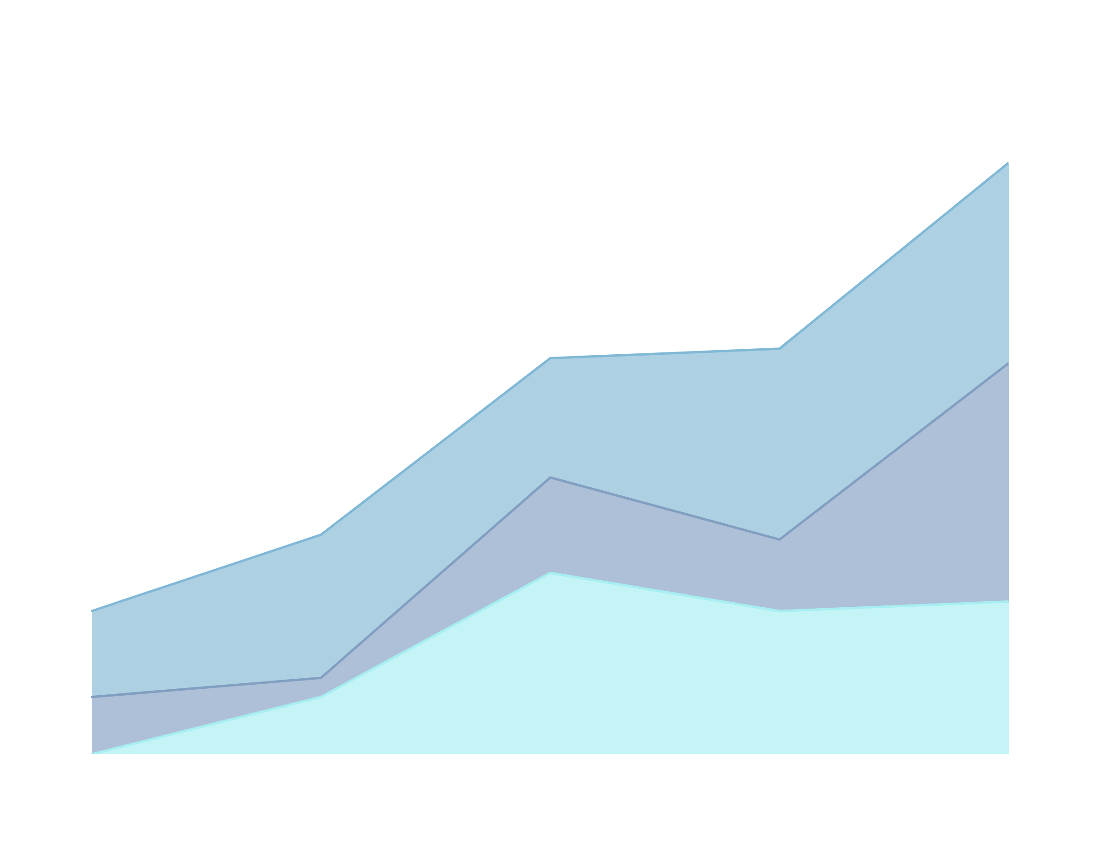
SALES DASHBOARD SUMMARY
CLASS COMPREHENSIVE BUSINESS INSIGHTS FROM SALES DATAPRESENTATION

Slide 2

Key Metrics Overview:
Tools : Power BI for data visualization and analysis
Source: Sales dataset
Tools Used in Power BI:
Card Visuals for KPIs (Profit, Sales, Quantity, Orders)
Measure fields using DAX: SUM(SalesAmount), SUM(Profit), etc.
Sales/Profit Analysis:
High total profit (₹756K) indicates profitability
Moderate order count (547) suggests fewer, high-value transactions
Average order value and quantity hint at possible B2B sales

Slide 3

Sales Quantity by State:
Sales/Profit Analysis:
New York, California, and Ohio are the top 3 contributors
High concentration of sales in eastern and central US
Opportunity to boost engagement in Texas and Illinois
Tools Used in Power BI:
Bar Chart using State (Axis) and SUM(Quantity)
Sort by value to highlight top contributors
Data cleaning in Power Query Editor to format regions

Slide 4
Profit vs Sales by City:
Sales/Profit Analysis:
Positive correlation observed: higher sales = higher profits
A few cities are underperforming in profit despite decent sales
Ideal cities for focus: those with high returns and efficiency
Tools Used in Power BI:
Scatter Chart with X-axis = Sales Amount, Y-axis = Profit
Tooltip customizations to show values per city
Size and color used to indicate volume/variation

Slide 5
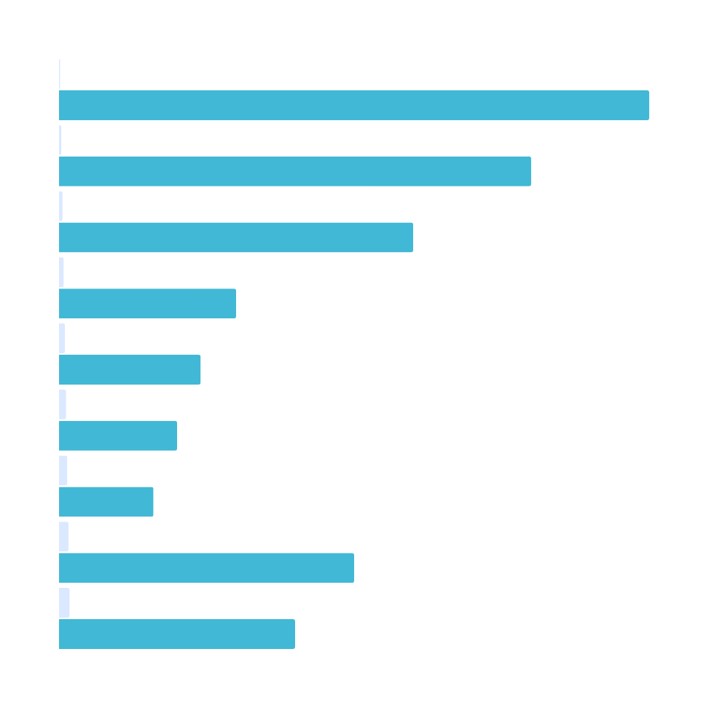
Orders by Payment Mode :
Tools Used in Power BI:
Bar Chart using State (Axis) and SUM(Quantity)
Sort by value to highlight top contributors
Data cleaning in Power Query Editor to format regions
Sales/Profit Analysis:
Debit Card is the most common method (21.67%)
COD and UPI are used almost equally
EMI is least used — potential to introduce awareness campaigns

Slide 6
Profit Trend Over Years:
Tools Used in Power BI:
Line Chart with Year on X-axis, SUM(Profit) on Y-axis
Calculated column for extracting Year from date
Custom color themes for readability
Sales/Profit Analysis:
Profits remained stable until 2023
Drop in 2024 may signal operational issues or market shifts
Partial recovery in 2025—explore what strategies worked

Slide 7
Monthly Product Sales Trend
Tools Used in Power BI:
Area Chart with Month on X-axis, SUM(SalesAmount) on Y
Date hierarchy enabled, filtered to Month level
Smooth visuals using transparency and color gradient
Sales/Profit Analysis:
April, June, and December are peak sales months
September has the lowest sales—target for improvement
Seasonal marketing campaigns can increase consistency

Slide 8
Sales by Product Category
Tools Used in Power BI:
Pie Chart with Category and SUM(SalesAmount)
Customized slice colors for visual distinction
Used category dimension table for clean joins
Sales/Profit Analysis:
Office Supplies dominate (60.62%)—likely large corporate buyers
Electronics perform well, furniture underperforms
Consider bundling furniture with electronics or targeting new segments

Slide 9
Interactive Filters Used
Tools Used in Power BI:
Slicers for PaymentMode and Category
Applied across all visuals using Sync Slicers
Multi-select enabled for better drill-down
Sales/Profit Analysis:
These filters allow interactive exploration of customer preferences
Analysts can filter by categories to find pain points
Example: Comparing profit margin of Furniture by payment type

Slide 10
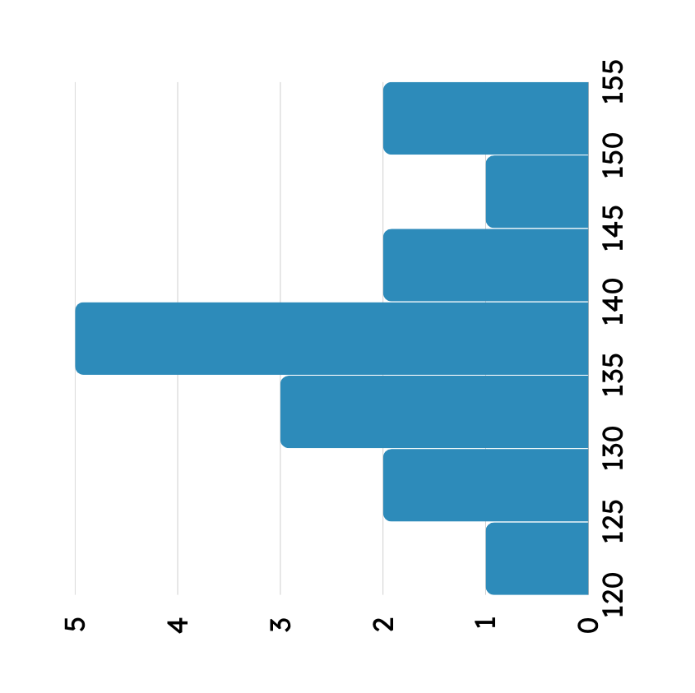
Summary & Insights
Tools Used in Power BI:
Unified dashboard layout using grids and panels
Page formatting to ensure mobile/tablet compatibility
Bookmarks and filters for storytelling (if published)
Sales/Profit Analysis:
Strong profit despite modest order volume
Payment behavior is diverse—flexibility is a strength
Focus on seasonal spikes, explore low-performing months
Furniture and EMI need strategic improvement

